Slide 1

A3-PS005-TC512
Explainable BGP Origin and Subprefix Anomaly
Mradul Gupta mradul0507@gmail.com | Jyotiranjan Moharana jr.moharana2340@gmail.com | Jagdeep Kaur gahuniajagdeep@gmail.com
AIORI Hackathon 3
October 14, 2026

Slide 2
AIORI 3
Abstract
Problem Description
BGP (Border Gateway Protocol) enables autonomous systems (ASes) to exchange network reachability information. However, incorrect or malicious route announcements can redirect traffic, disrupt connectivity, or expose communications to interception.
Origin hijacking: An AS announces a prefix that it is not authorized to originate.
Subprefix anomalies: A more-specific prefix is announced unexpectedly, potentially attracting traffic away from the legitimate route.
Limited context: An unusual announcement may be difficult to distinguish from legitimate routing changes.
Fragmented evidence: Origin authorization, historical routing behaviour, and observations from multiple monitors may need to be examined separately.
Alert fatigue: Alerts without clear evidence or explanations can increase the burden on network operators.
Problem Statement: Develop a transparent monitoring system that detects suspicious BGP origin and subprefix announcements and provides evidence that helps network operators investigate them.
M. Gupta et. al. · A3-PS005-TC512 · October 14, 2026

Slide 3
AIORI 3
Background
Background
BGP exchanges reachability information between autonomous systems using IP prefixes and AS paths.
A prefix identifies an IP address range; a subprefix is a more-specific range contained within a broader prefix.
Route Origin Validation (ROV) uses Resource Public Key Infrastructure (RPKI) and Route Origin Authorizations (ROAs) to assess whether an origin AS is authorized to announce a prefix.
ROV classifies a route as Valid, Invalid, or NotFound according to available authorization data.
Historical announcements help identify unexpected origin changes, newly observed subprefixes, and deviations from established routing patterns.
No single signal proves malicious intent. Legitimate routing changes can also appear unusual, and RPKI origin validation does not validate the complete AS path.
Proposed Optimization: Combine origin validation, historical context, and corroborating routing observations in a single explainable detection pipeline.
M. Gupta et. al. · A3-PS005-TC512 · October 14, 2026

Slide 4
AIORI 3
Literature & RFC Review
Literature & RFC Review
RFC 6811 — BGP Prefix Origin Validation [1]
Defines a mechanism for validating whether the origin AS of a BGP route is authorized to originate the announced prefix. It establishes the basis for RPKI-based Route Origin Validation but does not validate the complete AS path.
RFC 9582 — A Profile for Route Origin Authorizations (ROAs) [2]
Defines the standard profile for ROAs, which associate address prefixes with authorized origin ASes. It supersedes RFC 6482 and provides the authorization data used in the proposed validation stage.
ARTEMIS — Real-Time BGP Hijack Detection [3]
ARTEMIS is an existing open-source system for detecting BGP prefix hijacking using routing monitors and operator-defined prefix and origin information. It demonstrates the value of combining monitoring, detection, and operator-facing alerts.
CAIDA BGPStream [4]
BGPStream provides a framework for accessing and processing BGP monitoring data. It is a suitable candidate for collecting routing observations from supported sources in the proposed prototype.
Research Direction: Build on established BGP monitoring and RPKI mechanisms by presenting each anomaly alongside its validation result, historical context, and supporting observations. The proposed design complements existing systems rather than claiming to replace them.
M. Gupta et. al. · A3-PS005-TC512 · October 14, 2026

Slide 5
AIORI 3
Proposed Solution
Proposed Solution
Explainable BGP Origin and Subprefix Anomaly Detection
The proposed system combines BGP observations, RPKI origin validation, prefix history, and transparent detection rules to identify suspicious announcements and provide actionable explanations.
1. BGP Data Ingestion
Collect routing observations from RIPE RIS and RouteViews using BGPStream-compatible interfaces.
Extract prefix, origin AS, AS_PATH, timestamp, and monitor information.
2. Data Normalization
Standardize route records and remove duplicate observations where appropriate.
Maintain a consistent representation of prefixes and origin ASes.
3. Context Enrichment
Validate prefix-origin relationships against available RPKI/ROA data.
Retrieve historical origins and previously observed announcements.
Compare announcements across available monitoring sources.
4. Anomaly Detection
Flag RPKI-invalid origin announcements.
Detect unexpected origin-AS changes.
Identify newly observed or suspicious more-specific prefixes.
Evaluate whether multiple monitors corroborate the observation.
5. Explainable Alert Generation
Record the triggering rule, affected prefix, observed origin AS, validation state, historical comparison, and supporting observations.
Present the evidence through an operator dashboard.
6. Operator Review
Allow analysts to inspect, acknowledge, investigate, and classify alerts.
Keep mitigation decisions under operator control.
M. Gupta et. al. · A3-PS005-TC512 · October 14, 2026

Slide 6
AIORI 3
Solution Optimization
Optimization Proposed
Expected Benefits
More consistent identification of suspicious origin and subprefix announcements.
Reduced manual effort in correlating routing evidence.
Greater transparency into why an alert was generated.
Better separation of suspicious observations from confirmed malicious activity.
Improved support for repeatable investigation and incident documentation.
Aspect | Conventional workflow | Proposed optimization
Origin validation | Consult authorization data separately | Integrate RPKI/ROA validation into the detection pipeline
Historical context | Investigate past announcements manually | Maintain prefix and origin history for comparison
Subprefix monitoring | Examine more-specific announcements individually | Detect and correlate suspicious subprefix announcements
Multiple monitors | Review observations separately | Correlate observations from available monitors
Alert explanation | Interpret raw routing events | Show triggering rules and supporting evidence
Investigation | Switch between data sources and tools | Present alert details and evidence in one interface
Response | Apply decisions using separate workflows | Support structured analyst review and acknowledgement
M. Gupta et. al. · A3-PS005-TC512 · October 14, 2026

Slide 7
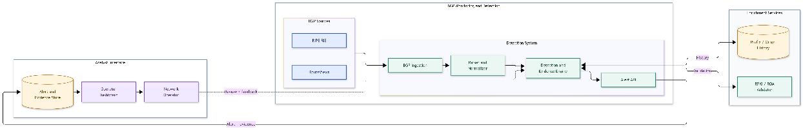
AIORI 3
Solution Architecture & Design
Architecture Design (UML Diagram)
Figure: System Architecture UML Diagram
M. Gupta et. al. · A3-PS005-TC512 · October 14, 2026

Slide 8
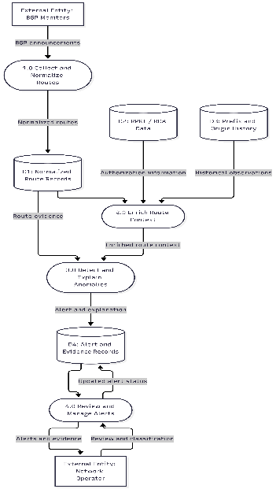
Data Flow Diagram
AIORI 3 Data Flow Diagram
The Data Flow Diagram (DFD) illustrates how BGP announcements are collected and normalized, enriched using RPKI/ROA authorization data and historical routing observations, and analysed to detect and explain anomalies. The resulting alerts and supporting evidence are stored for review, allowing network operators to investigate findings, classify incidents, and update alert statuses.
Figure: Data Flow Diagram (DFD)
M. Gupta et. al. · A3-PS005-TC512 · October 14, 2026

Slide 9
AIORI 3
Deployment Timeline
Deployment Timeline
Phase | Timeline | Key activities | Deliverable
1. Requirements and design | Days 1–2 | Define anomaly categories, data fields, and detection rules | Requirements and architecture
2. Data ingestion | Days 3–4 | Connect to BGP data sources and normalize route records | Ingestion module
3. Context enrichment | Days 5–6 | Integrate RPKI/ROA validation and prefix-origin history | Enrichment module
4. Detection engine | Days 7–9 | Implement origin-change, invalid-origin, and subprefix rules | Detection and evidence engine
5. Dashboard integration | Days 10–11 | Display alerts, evidence, validation status, and history | Analyst interface
6. Testing and evaluation | Days 12–13 | Replay selected routing observations and test known scenarios | Test report and identified limitations
7. Final integration | Day 14 | Validate end-to-end workflow and prepare demonstration | Integrated prototype and presentation
M. Gupta et. al. · A3-PS005-TC512 · October 14, 2026

Slide 10
Bibliography
Bibliography
[1] BGP Prefix Origin Validation
P. Mohapatra, J. Scudder, D. Ward, R. Bush, and R. Austein, “BGP Prefix Origin Validation,” RFC 6811, Internet Engineering Task Force, January 2013.
https://www.rfc-editor.org/rfc/rfc6811.html
[2] A Profile for Route Origin Authorizations (ROAs)
J. Snijders, B. Maddison, and M. Lepinski, “A Profile for Route Origin Authorizations (ROAs),” RFC 9582, Internet Engineering Task Force, May 2024.
https://www.rfc-editor.org/rfc/rfc9582.html
[3] ARTEMIS: Neutralizing BGP Hijacking Within a Minute
P. Sermpezis, V. Kotronis, P. Gigis, X. Dimitropoulos, D. Cicalese, A. King, and A. Dainotti, “ARTEMIS: Neutralizing BGP Hijacking Within a Minute,” IEEE/ACM Transactions on Networking, vol. 26, no. 6, pp. 2471–2486, December 2018.
https://doi.org/10.1109/TNET.2018.2869798
[4] BGPStream: A Software Framework for Live and Historical BGP Data Analysis
C. Orsini, A. King, D. Giordano, V. Giotsas, and A. Dainotti, “BGPStream: A Software Framework for Live and Historical BGP Data Analysis,” in Proceedings of the 2016 ACM Internet Measurement Conference (IMC), pp. 429–444, November 2016.
https://doi.org/10.1145/2987443.2987482
M. Gupta et. al. · A3-PS005-TC512 · October 14, 2026

Slide 11
Thank You for Your Attention!

